Slide 1
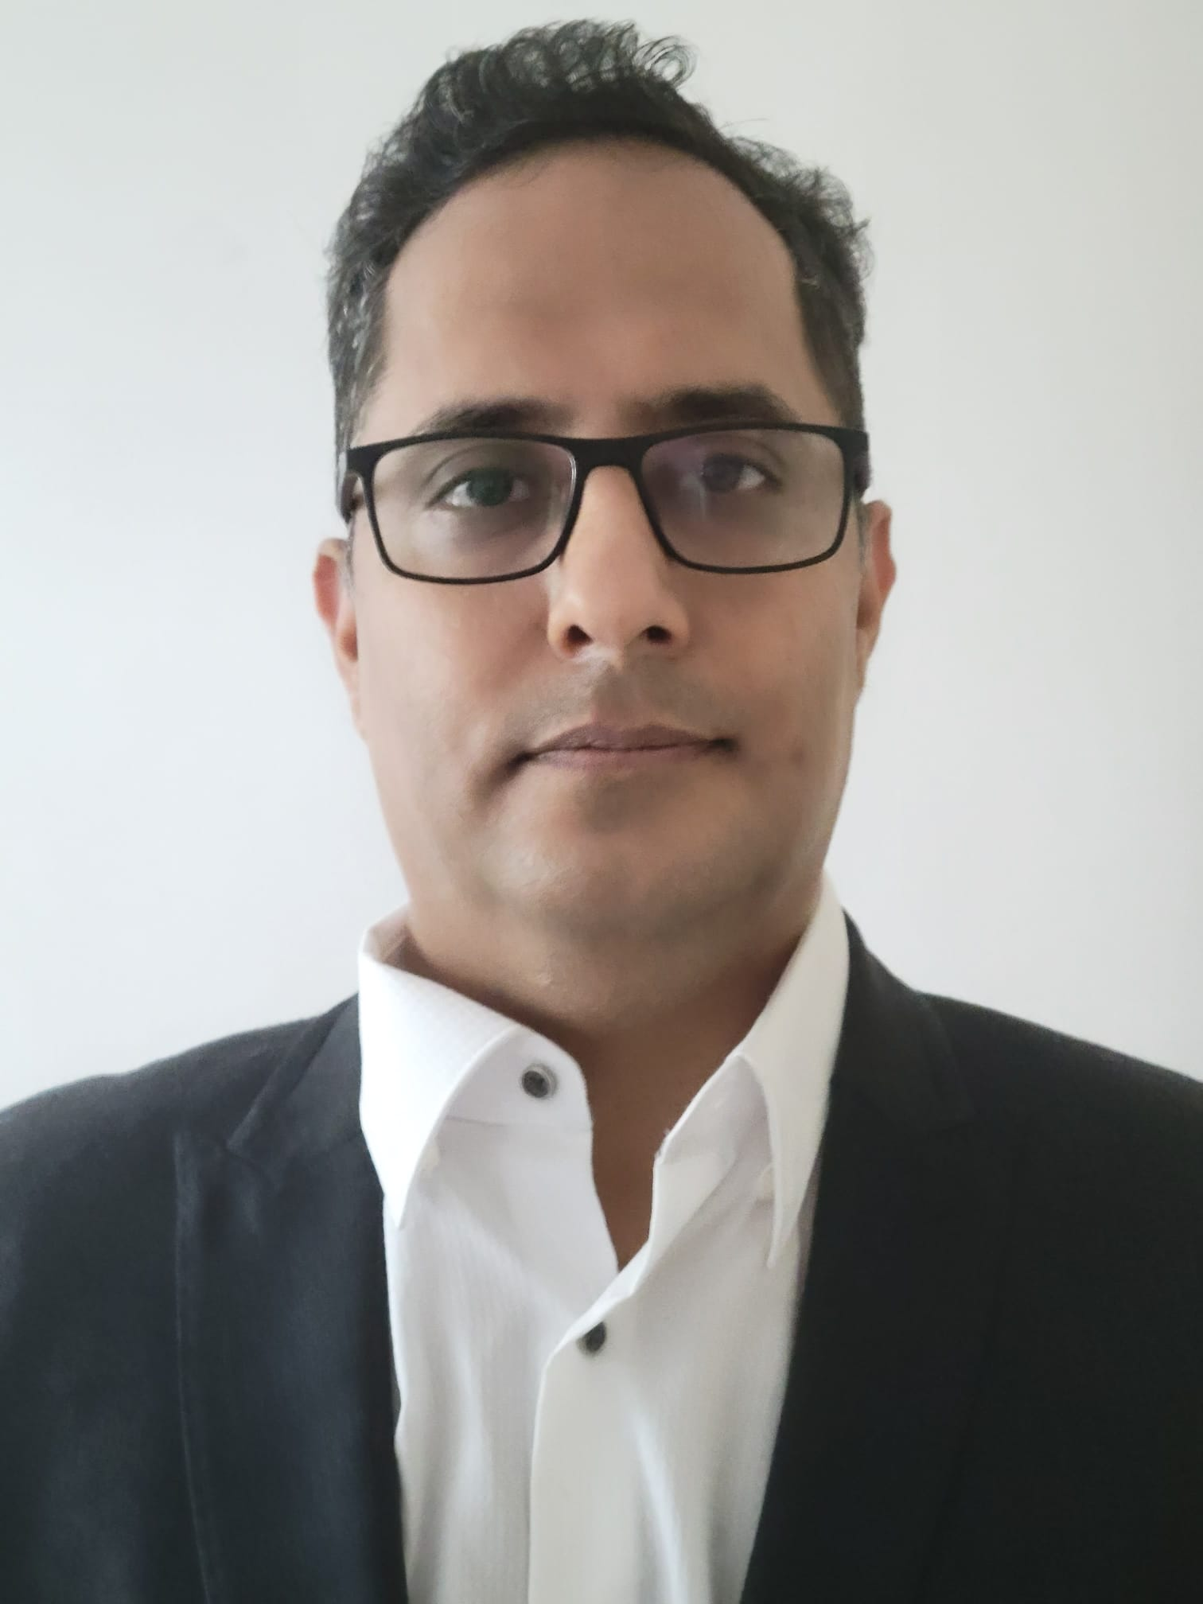
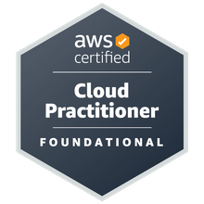
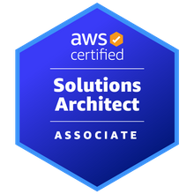
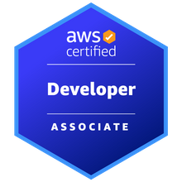
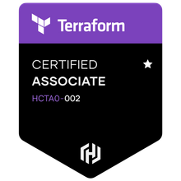



Mayank Chugh
LinkedIn: www.linkedin.com/in/mchugh44
Git: https://github.com/mayankchugh1977
Senior Technical Manager (Cloud + Application)
Email: mayankchugh.jobathk@gmail.com
Mobile: +852 84812040
Summary
Hands-on solution-driven IT professional with 18+ years of extensive experience as a consultant, solution architect, security Designs, project manager, team lead, and senior engineer for multiple software development projects. Focus on Pre-sales, Architecture Vision, Business Architecture, Technology Architecture, helping clients for preparing Strategy and Roadmap for Cloud Migration Solution, project management and adhere to SLAs. Energetic and recognized for having excellent communication and problem-solving skills spanning multiple technical towers and global enterprises.
Skills
Project lifecycle management; Project manager supervision; Architecture Change Management; Migration Planning; Release management; Technical project planning; Project requirements analysis; Build technical teams; Technical documentation understanding; Solution Technical architecture (Application + Cloud); Security Designs/Patterns; Project scheduling and budgeting; Custom software development and database design; System migration/integration; Quality assurance
Cloud Services: AWS; DevOps: GIT, Jenkins pipeline, AWS CI/CD pipeline, Ansible, Containers, K8S, Terraform;
Languages: Java / J2EE, EJB, Spring Boot, JavaScript, Struts 1.x MVC, Python;
Databases: Oracle, MySql; Reporting tools: iReport, Jasper Report; Version Control: GIT, SVN, VSS;
Web Services: SOAP, Rest API Development;
Management Tool: JIRA, Confluence; Maximo, Bugzilla;
Machine Learning: Supervised Learning – Linear/Logistic Regression, Decision Tree, Random Forrest Tree;
Operating Systems: Windows (XP, 10), Lunix and Ubuntu; Methodologies: Agile, Waterfall Model

Slide 2
Relevant Experience
Client: CHANEL
Participated in Pre-sales activity for providing High availability, Fault tolerant and resilience application to the client.
Contributing as SME for application implementation and Azure cloud for accepted SLA, RPO and RTO.
Working closely with delivery head, fellow Architects and other members for delivering complete IT solutions.
Client: HSBC
Gathered project requirements for setting up application on Cloud through interactions, meetings, and walkthroughs with potential application users functional and non-functional requirements.
Server side API designing, Security Patterns designs decision and Providing AWS architecture for setting up AWS EKS cluster having Jenkins CI/CD pipeline.
Client: Cathay Pacific Cargo Terminal & Asia Airfreight Terminal
Gathered project requirements (150+ of AAT and 35+ of CPSL) through interactions, meetings, and walkthroughs with potential application users to develop/design business requirements documents (BRD). Also, I created 55+ technical responses to Requests for Quotes (RFQs) for customers.
I Provided winning solutions as part of the pre-sales team, which included responding to RFPs and RFIs from existing and prospective clients. Recently, involved in a proposal for the migration of Monolithic to cloud study. Conducted a few POCs for the same Participated in both pre-sales and post-sales activities, including establishing statements of work, responsibility matrixes, and overseeing the technical realization of solutions by delivery teams.
Worked closely with executive sales teams to deliver quotes and full IT solutions in networking, computing, storage, and virtual cloud infrastructure. Also, Designed and developed projects: On-premise Storage move to AWS, OCR using AI Computer vision, AWS IOT using MQTT (pub/sub) for controlling Cold Box for warehouse cargo application.
Monitor SLA and tested application performance to identify potential bottlenecks, develop solutions, and collaborate with developers on solution implementation for 5 Web, 3 Mobile applications. Provided 2nd and 3rd level technical support and troubleshooting to internal and external clients. Team Size - 4 - on-site resources, 4 - offshore resources.
Successfully managed multimillion-dollar revenue accounts including focus on several Completed 15.5K days of works. I have managing releases during all phases of software development life cycle, from requirements analysis through system implementation for more than 2 enterprises projects. Worked closely with customers, internal staff and other stakeholders to determine planning, implementation and integration of system-oriented projects. System development of RESTful API for having interface with HKIA.

Slide 3
Projects & POCs
Storage S3, CLI - Cloud Computing on AWS
On Premises File Storage to AWS S3
Provides fault tolerant, highly available design → development → deployment → monitoring → maintenance → data analytics support for file upload Migration from on-prem files storage to AWS S3 bucket logic. In-addition, This enhancement provides the capability to upload the image, document, video and store the files in AWS S3 Bucket instead of on prem storage.
Skills and Tools - S3, AWS SDK (Java), awscli
WebLogic to Jboss and Oracle to MySQL Migration – Monolithic Application Migration to AWS Cloud
On Premises Application Migration to AWS - POC
As part requirement client want to migrate application. We would need prepare quicker roadmap to best optimal ways for migration for Monolithic application to AWS Cloud with all possible options. As a vendor, we have migrated basic framework and one of module of existing from Weblogic application Server to Jboss Server. Also, We have done all required changes for migrating Oracle database to Mysql/Aurora database.
Skills and Tools – RedHat Jboss migration tool, Jboss The AWS Schema Conversion Tool (AWS SCT)
Mobile Apps Development for Cargo Users – Development and Magnificence for iOS and Android Application
Hybrid Cloud Management – combination of Public and Private cloud
Provide cost optimization solution, Business, information and technology architecture and maintenance support to client for their new Mobile apps and upgrades Mobile Apps. To handle complex business functionality of Transhipment and intermodal functionalities. Application should allowed the agents, truck drivers and carrier airlines to view schedule and status of flights so that the shipment can be planned for delivery and pick-up. This app enabled user to track the status of Export/Import/Transhipment shipments. It also provid notifications to the user when the Import shipment is ready for pickup so that user can plan and schedule the travel to Cargo Terminal to pick-up the same. It reduced the customer support effort of Cargo Terminal Operator by self-servicing of flight schedule/AWB Enquiry and Notification. It also allowed users to choose languages of choice.
Skills and Tools – J2EE, Oracle, App Notification and Google Notification

Slide 4
Key Result Areas
Solution Architecture
A customer-centric leader with strong analytical, design and problem solving skills
Interacting with clients for business gathering, conducting system analysis to propose/finalize Infrastructure & Application design specifications.
Further conduct mockup interview with teams to discuss functional & Non-Functional requirement and Security aspects; also help in preparing high level design documents for the project;
I contribute teams as SME to the design, development, testing, troubleshooting and debugging during the process phases.
Reviewing design documents, code & approving results during for critical functionalities of the projects; identifying & highlighting risks and issues in project followed by appropriate escalation; providing post-implementation, application maintenance and enhancement support to the client with regard to the product / software application
Production Deployment & Support
Managing product release and working in close coordination with Development, QA, BE (Business Experts) to plan post deployment support
Providing post deployment support till successful release; rendering deployment support statistics for reporting bugs, issues & possible precautions; driving project change orders, rollback and error logs for change analysis.
Ensuring continual improvement to ensure excellence in delivery through metrics-based measurement process & define quality management principles, & processes
Holding review meetings to monitor progress of the project as per schedule / budgets and ensuring timely completion and delivery of the project to the client.
Nurturing and deepening strong rapport with key stakeholders/partners/vendors for successfully establishing sound business relationships
Developing project baselines; monitoring & controlling projects with respect to cost, resource deployment, time over-runs and quality compliance to ensure satisfactory execution/deliver.

Slide 5
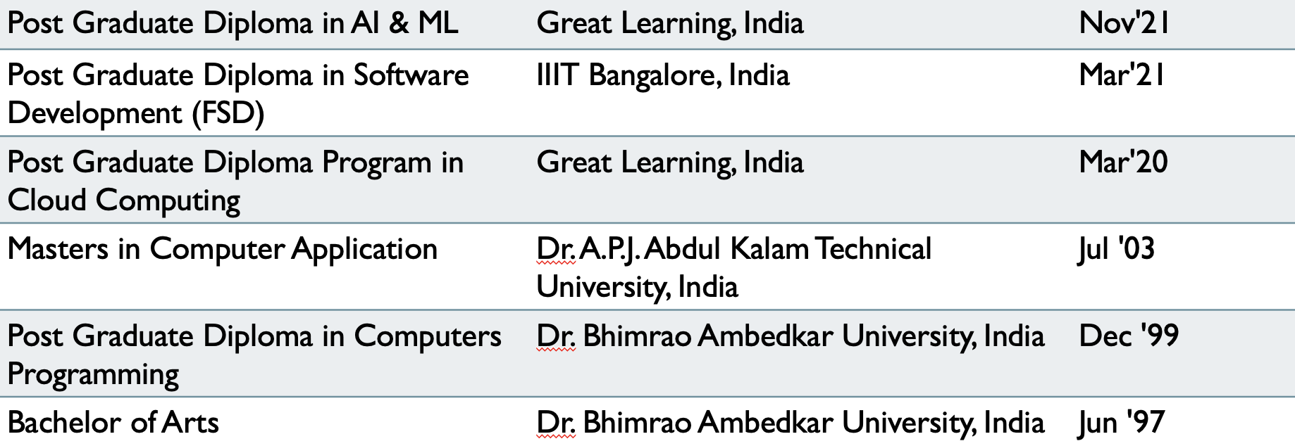
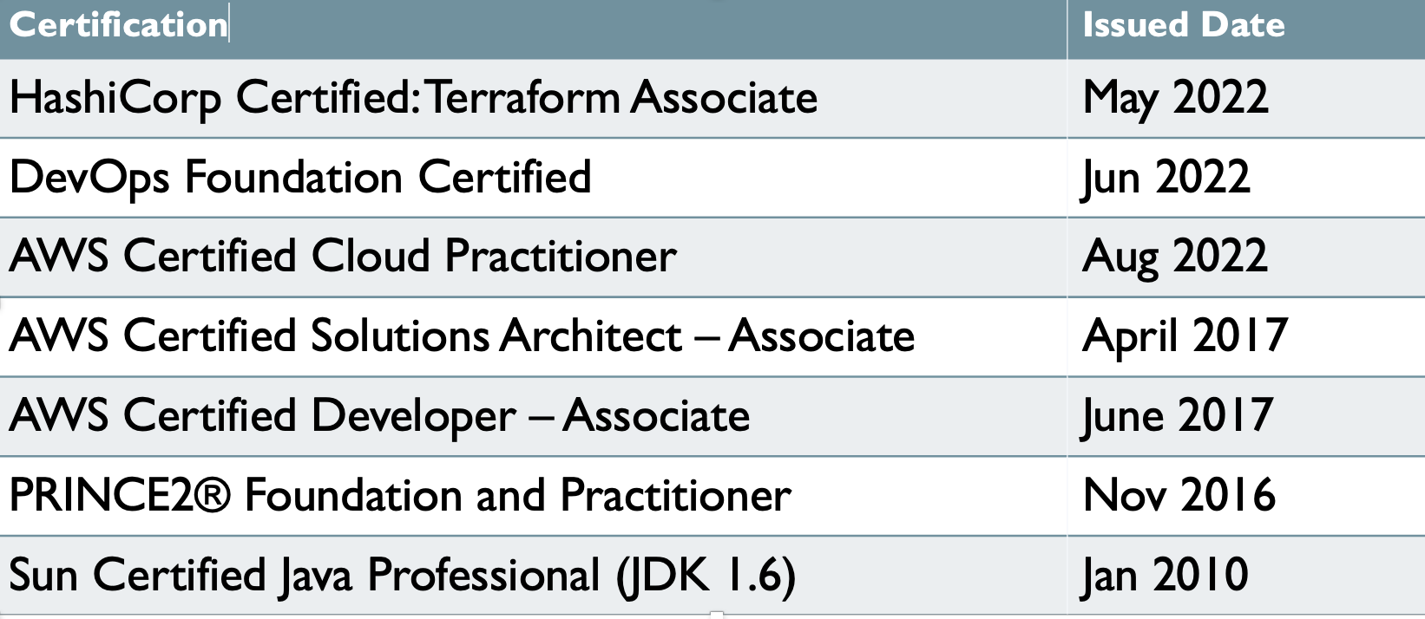
Key Result Areas (Contd.)
Project Execution
Manage projects including planning and execution; implementing project plans within preset budgets and deadlines; performed on-site and offsite tasks within a project scoping document, including the design, specification, and integration of software products within various customer environments.
Monitoring project progress and outstanding issues; ensuring the quality and timeliness of the deliverables; reporting on the project’s progress
Interacting with stakeholders to analyse and evaluate system program needs. Understanding the customer’s needs and expectations and managing resources to achieve customer satisfaction, ensuring zero defect project deliverables
Conducting quality & security audits and preparing various project teams for external audits/certifications; interacted with pre-sales & sales teams in ensuring that new Request for Proposals (RFP) was properly planned for execution
Working closely with third-party vendors & contractors to manage & coordinate projects with the business units and other IT departments, where necessary
Provided overall leadership to the entire project team including managing deliverables of other functional team leaders
Education
Academic
Certifications

